Slide 1
Course Introduction
Lecturer: Bui Ha Duc
Email: ducbh@hcmute.edu.vn

Slide 2
COURSE OBJECTIVES
Provide technology fundamentals of IoT
Hand-on IoT system design

Slide 3
Order of Instruction
Introduction to Internet of Things
Historical background
Applications
IoT Architectures
IoT layers
Hardware
1 week
1-2 weeks

Slide 4
Order of Intruction
Communication Protocols
Between devices
Over the Internet
Web Design and Database
Data Analysis and Cloud services
System Design
3-4 weeks
2-3 weeks
2-3 weeks

Slide 5
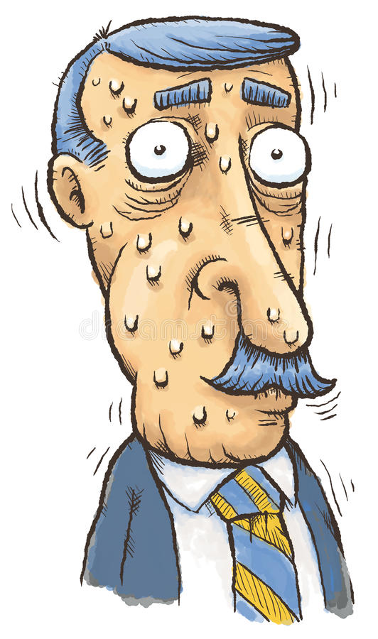
Assessments
In-class assignments – 50%
Final Project – 50%

Slide 6
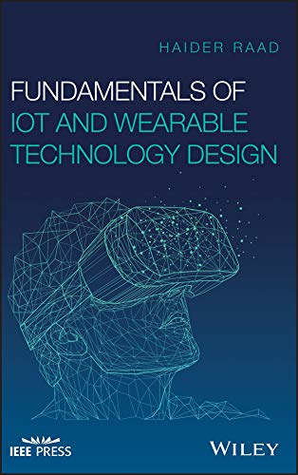
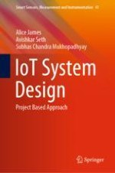
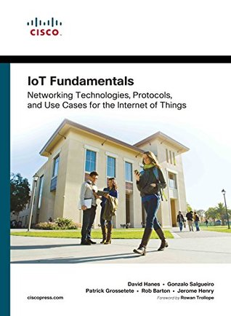
References – Textbook
Fundamentals of IoT and Wearable Technology Design – Wiley, 2021
IoT System Design – Springer, 2022
IoT Fundamentals: Networking Technologies, Protocols, and Use Cases for the Internet of Things – Cisco Press, 2017

Slide 7
Internet of Things
IoT is an ecosystem of internet connected devices with the ability to collect and transfer information over a network to provide automated decision making
IoT focuses on connecting “things”
IoT is prime enabler for digitization

Slide 8
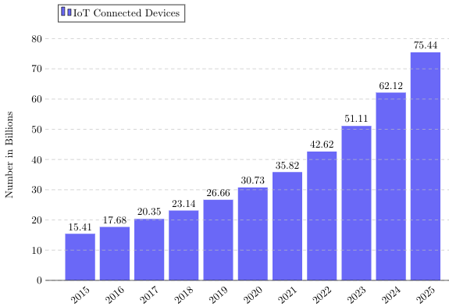
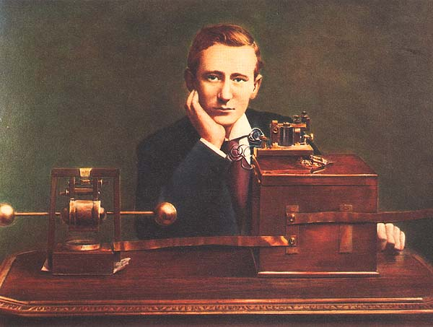
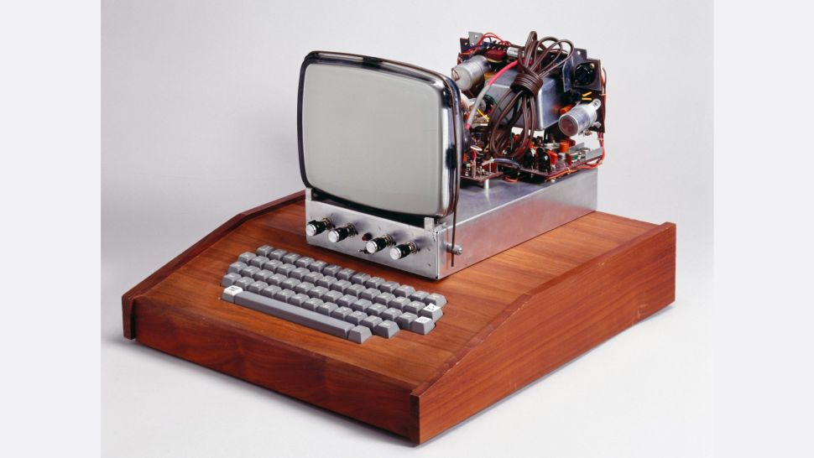
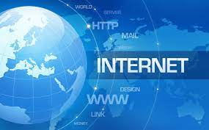
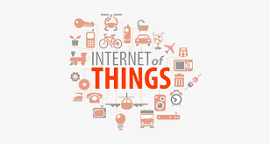
IoT: Historical background
1901
Invention of Radio communication
1950s
Inception of computers
1983
The born of Internet
1999
Kevin Ashton invented the term “Internet of Things”

Slide 9
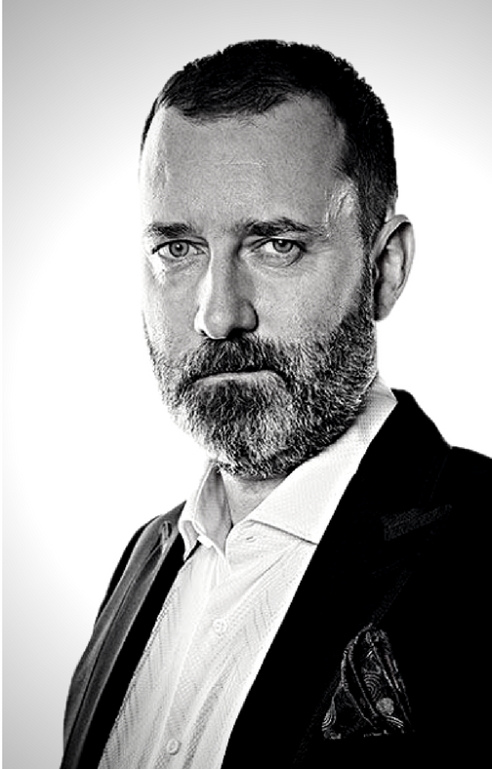
IoT: Historical background
“ Today computers, and, therefore, the Internet, are almost wholly dependent on human beings for information... The problem is, people have limited time, attention, and accuracy. All of which means they are not very good at capturing data about things in the real world. If we had computers that knew everything there was to know about things, using data they gathered without any help from us, we would be able to track and count everything and greatly reduce waste, loss and cost. We would know when things needed replacing, repairing or recalling and whether they were fresh or past their best. ”
Kevin Ashton, 1999

Slide 10
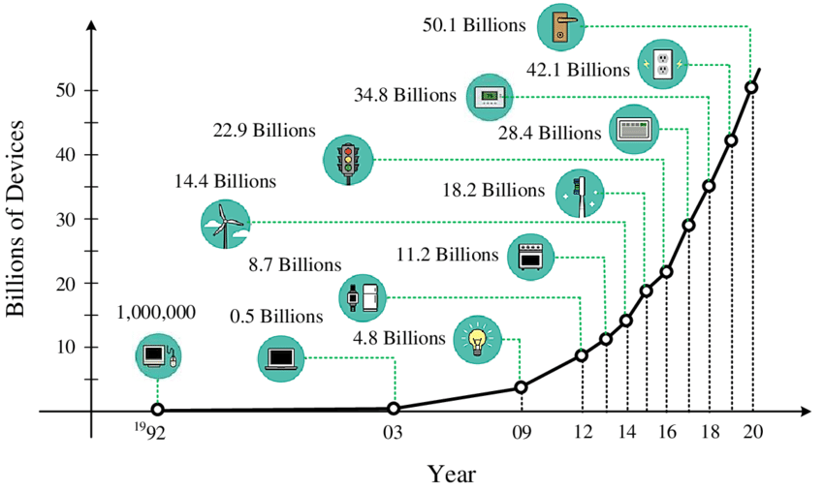
IoT: Historical background
Number of connected devices to the Internet
from Cisco and Ericsson report

Slide 11
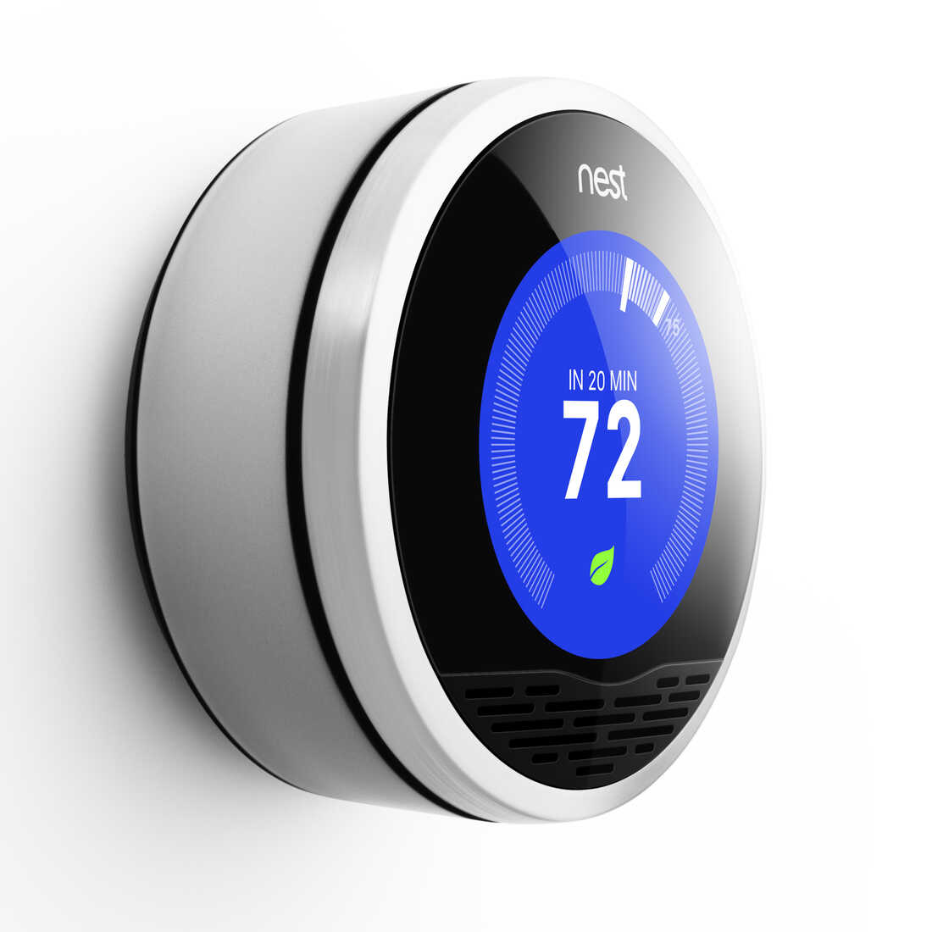
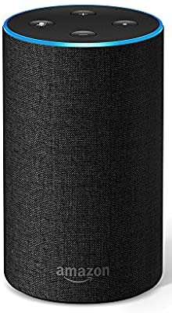
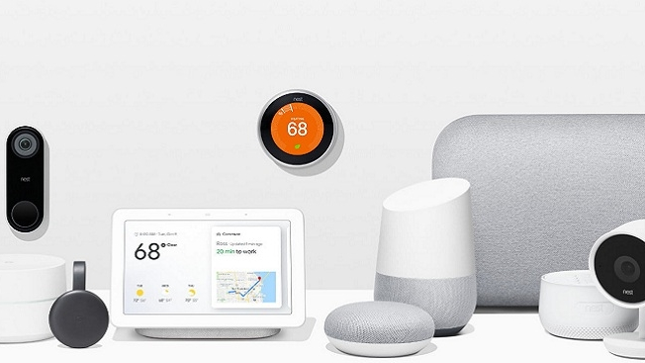
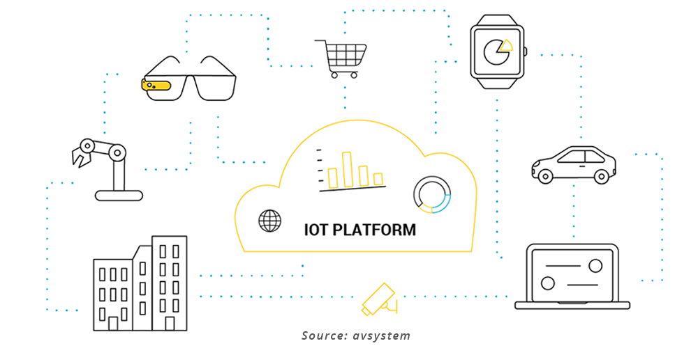
IoT: Historical background
2010 First IoT network
Nest smart thermostat network
2014 IoT devices
- Google Inc. acquires Nest
- Google‘s Smart home devices
- Google’s Self-driving car
- Amazon’s Echo, a voice-controlled devices
2016
- GM invested in self-driving car
- Apple’s HomeKit platform
- Google released Google Home
2017 IoT Platform
- Microsoft launched Azure IoT
- Google released Cloud IoT Core

Slide 12
IoT Trends
AI and IoT (AIoT)
Edge Computing
Massive IoT
Industrial Internet of Things (IIoT)
Healthcare - Internet of Medical Things (IoMT)
Supply Chain
Smart Cities & Utilities

Slide 13
IoT Challenges
Infrastructure gap
“Internet gap” and “AI gap”
Security and Privacy
Sharing individual information
Big data and data analytics
Massive amount of data
Interoperation
Various protocols and architectures in the market

